Slide 1


Beyond4P Installation and Getting Started Versions available for Windows (at least Windows 7), LINUX and MACOS
2020-01-20 Georg zur Bonsen

Slide 2

Table of Contents
1. Installation on WINDOWS systems
2. Installation on LINUX systems

Slide 3

Beyond4P Installation and Getting Started
You should have available two compressed files:
B4P Installation.zip Lean installation package containing all necessary files
B4P Demo.zip Nice collection of demonstrator applications written in Beyond4P
Beyond4P Getting Started.pdf Guide to installation
The installation file is OS specific, but demo and PDF files are common.
Windows users: In order to use the ZIP Library and Office Library functions, e.g. loading Excel files in .xlsx / .xlsm formats, you need to install following ZIP "7-zip" if you have not done so earlier.
Download is free of charge, "GNU Lesser Public License" (LPGL). See https://www.7-zip.org/
You can download and install 7-zip it before or after installing Beyond4P. No need to re-install 7-zip in case you install a newer Beyond4P version replacing an older one.
Without 7Zip installed, Beyond4P will issue exceptions (error messages) when attempting to use these functions and stop running.

Slide 4
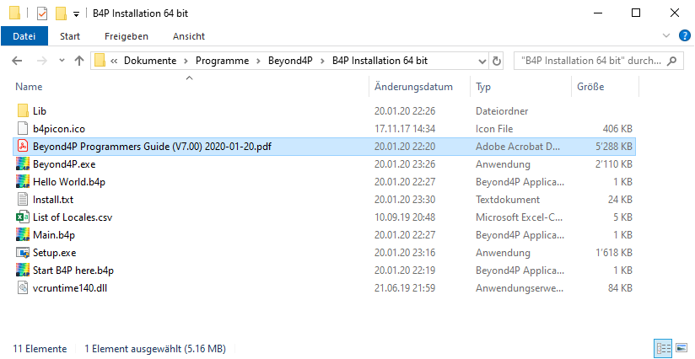
Beyond4P Installation and Getting Started Starting the Installation
Extract the .zip file on a new local directory.
Most files will be copied into the location C:\Program Files (x86)\Beyond4P.

Slide 5
Beyond4P Installation and Getting Started B4P Installation.zip
Extract the .zip file on a new local directory.
Setup.exe Automatic Beyond4P installation program (click to start)
Install.txt Actual Beyond4P installation script (written in Beyond4P)
Beyond4P.exe Actual Beyyond4P run time machine (language interpreter)
vcruntime140.dll Required dynamic link library
b4picon.ico Colorful icon file (applied on files with filetype .b4p)
List of Locales.csv Contains locale information for a set of supported countries.
B4P Programmers Guide … .pdf Programmers guide
Start B4P here.b4p Small Beyond4P app which makes Beyond4P look for 'main.b4p' or 'main.txt' in this directory if not started with an B4P application script file (e.g. when starting Beyond4P from start menu or command line alone)
Main.b4p Typical main file. Put it in a favorable directory location (along with the file above).
Hello World.b4p Self-explanatory
Lib\.... Beyond4P library (contains 4 files, incl. Office and Excel related features)
Beyond4P License File.json Available if a valid license is provided.
Most files will be copied into the location C:\Program Files (x86)\Beyond4P.

Slide 6
Beyond4P Installation and Getting Started Starting the Installation
Run "Setup.exe"
Due to small number of files, the installation process will be very fast (like Beyond4P itself!)
The screen darkens. You will be asked whether the software is allowed to make changes on the system (enable elevated privileges) Click on "Yes".
The installer uses elevated privileges in order to obtain full access rights to "C:\Program Files …\..." and make a few additions in the registry (e.g. configurating mouse actions and icons to ".b4p" file type).
Most files will be copied into the location C:\Program Files (x86)\Beyond4P.

Slide 7
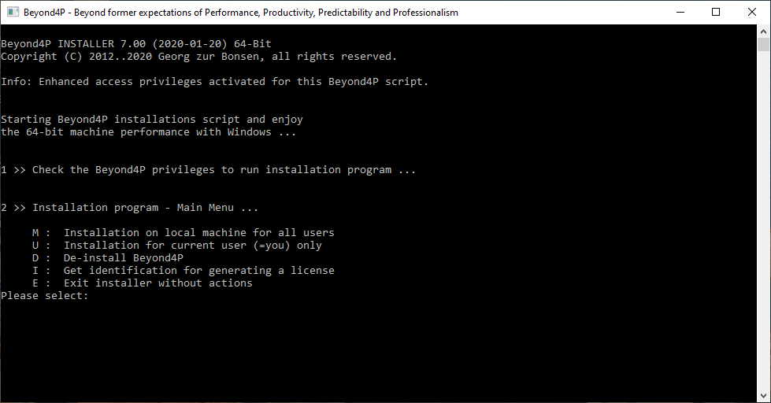
Beyond4P Installation and Getting Started Installation Options: Local Machine / Current User / De-Installation
Choose one of the options.
Press M for installation on the local machine. The installation will copy
The executable, program files and libraries to C:\Program Files\Beyond4P\
License file to C:\ProgramData\Beyond4P
other files like user settings to C:\Users\username\AppData\Local\Beyond4P
Alternative, U can bus used for current-user application were the program will also be stored in local applcation data.

Slide 8
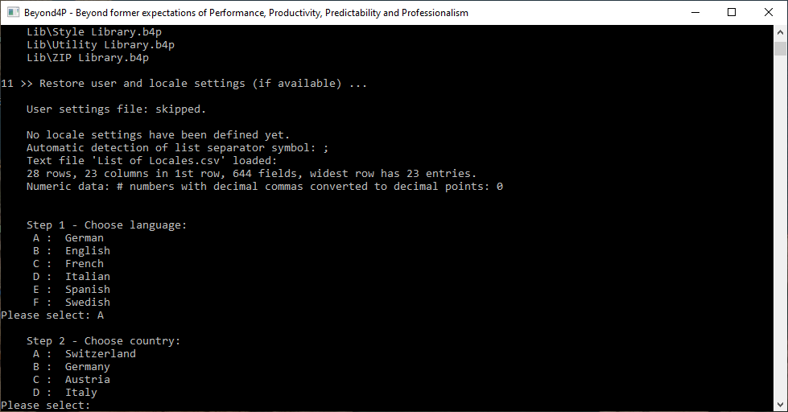
Beyond4P Installation and Getting Started Installation Options: Local Machine / Current User / De-Installation
Locale Settings
If no locale settings have been installed yet, then you will be asked for language followed by country.
If locale settings are found from a previous installation, then you will be asked if to use them again.
The list of countries is specific to the languages chosen.
Important: Please use the same locale settings as you are using for MS Excel (and not primarily where you are living) so no conflicts occur regarding decimal comma/points, thousand separators and list separators (, / ;).

Slide 9
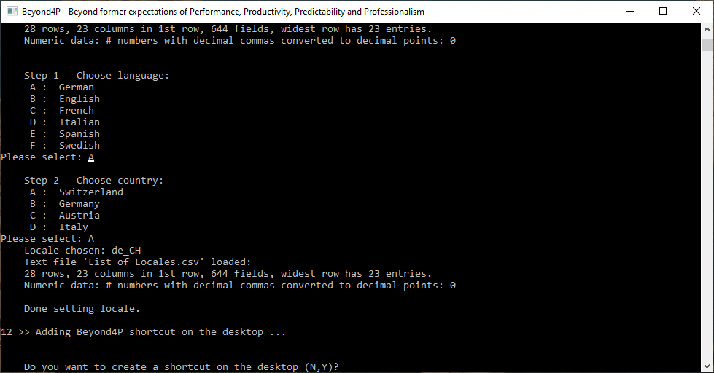
Beyond4P Installation and Getting Started Installation Options: Local Machine / Current User / De-Installation
Shortcut on desktop
You may optionally add a shortcut icon on the desktop.

Slide 10
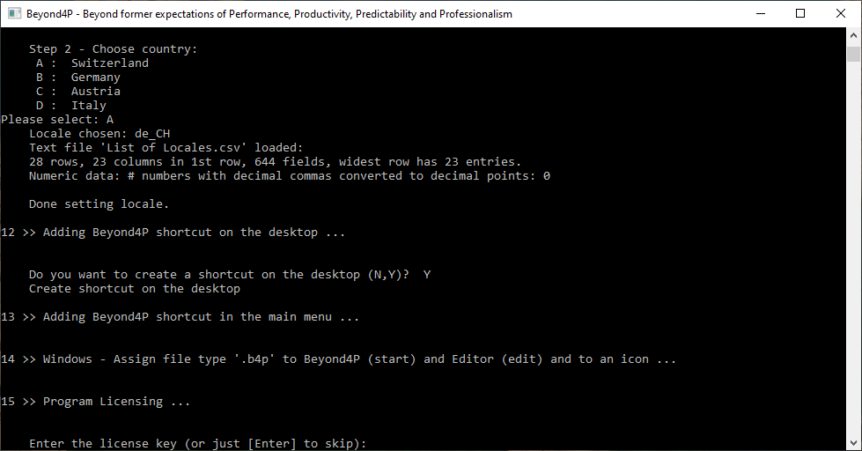
Beyond4P Installation and Getting Started License Key
If the installation file contains a license file or if your existing installation is already licensed, then you will be asked whether to use this one or not.
Without license key, Beyond4P runs in demo mode with full performance and functionality, but some restrictions apply:
5 'table save ...' operations per session
Max 300 rows allowed to save
Max 40 columns allowed to save
Either enter the license code (set of hexadecimal values, if available), just press [Enter] to skip.

Slide 11
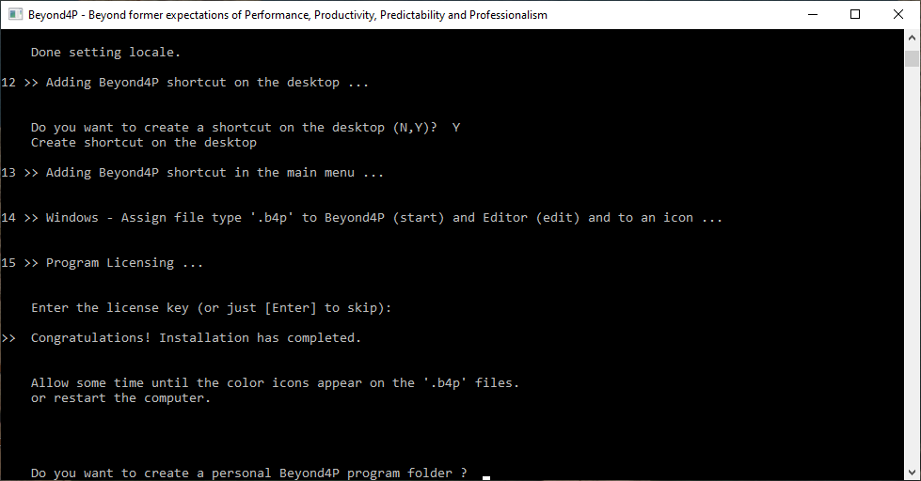
Beyond4P Installation and Getting Started Installation done, optional personal program folder
Roundup
The installation is ready.
You will be asked whether you want to have a personal program folder created where you can start "playing around".
For beginners: advisable to press Y.
Following folder will be created: C:\Users\username\Documents\Programs\Beyond4P
Afterwards, the installation is complete.
The colorful Beyond4P icon may appear with some delay, but latest if you restart the computer. Restarting is not needed to start Beyond4P itself.

Slide 12
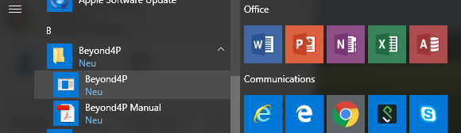
Beyond4P Installation and Getting Started You are ready to go
The Beyond4P program and library files are no longer needed in the decompressed directory. The user guide is also accessible from the start menu. You may delete these files, but desire to keep the ".b4p" files for later use.
Check if Beyond4P can be started from the main menu.
The user's manual is also accessible from the start menu.
When starting Beyond4P without a known starting directory, then it will tell you this and enter 'interactive mode'.

Slide 13
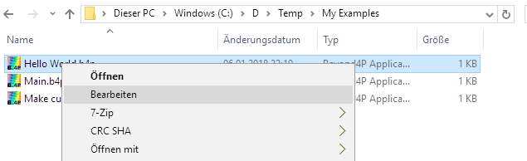
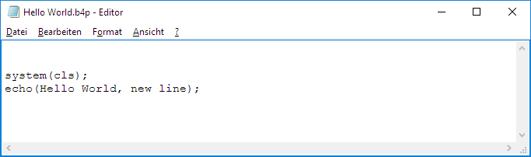
Beyond4P Installation and Getting Started Open Beyond4P Files to edit
Choose the file and click with right mouse button
A menu appears.
Open (Öffnen) Start Beyond4P Edit (Bearbeiten) Start editor to edit.

Slide 14
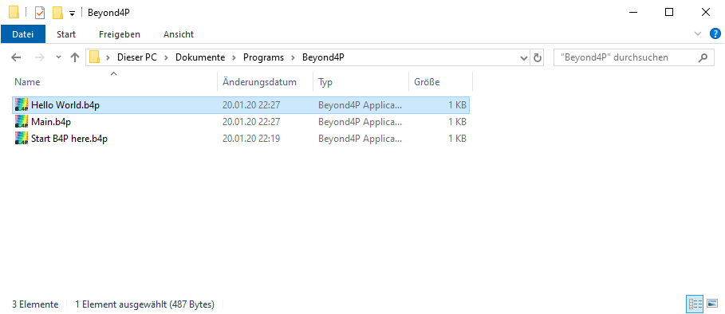
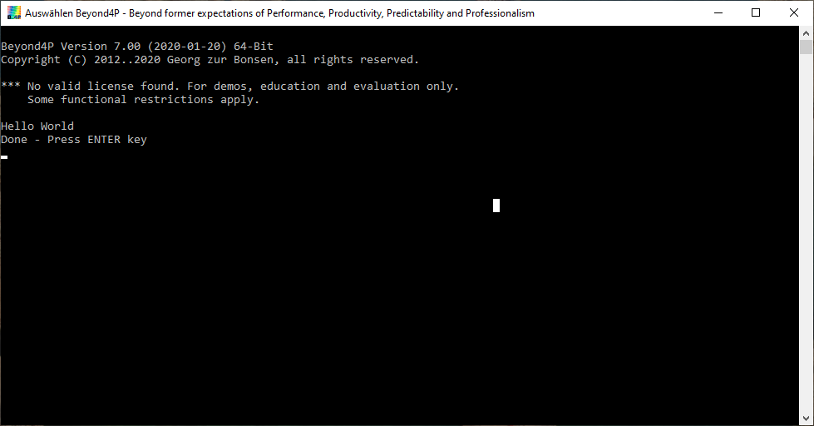
Beyond4P Installation and Getting Started First tries
Go to the new directory created:
Open Explorer or a file manager and go to directory
Click on "Hello World.b4p"

Slide 15
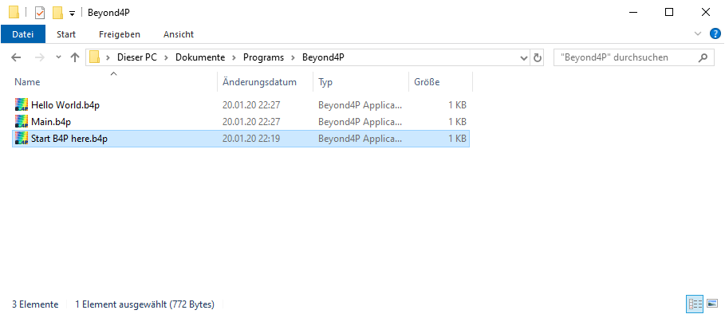
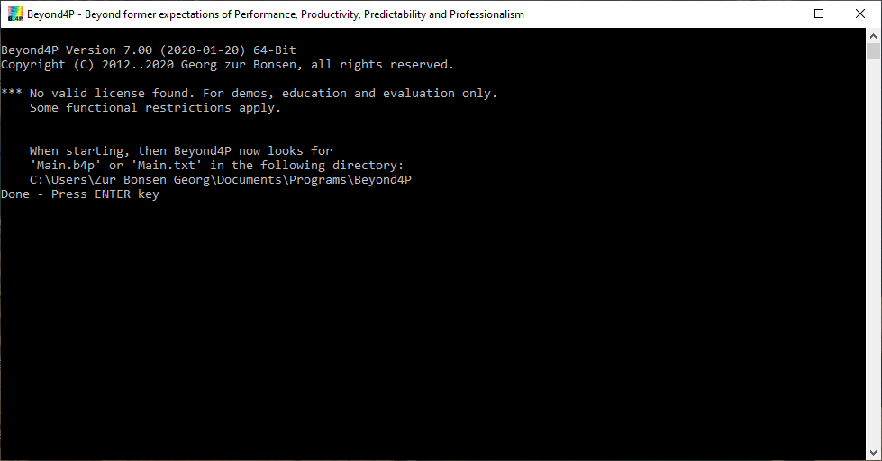
Beyond4P Installation and Getting Started Set the starting directory when launching Beyond4P directory.
Go to the new directory created:
Open Explorer or a file manager and go to directory
Click on "Start B4P here.b4p".
Now, beyond4P will look in this directory for "Main.b4p" or "Main.txt" if started autonomously without file name specified.

Slide 16
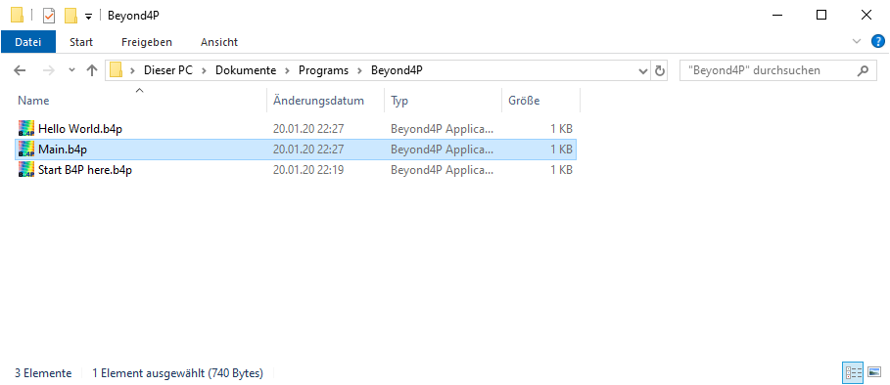
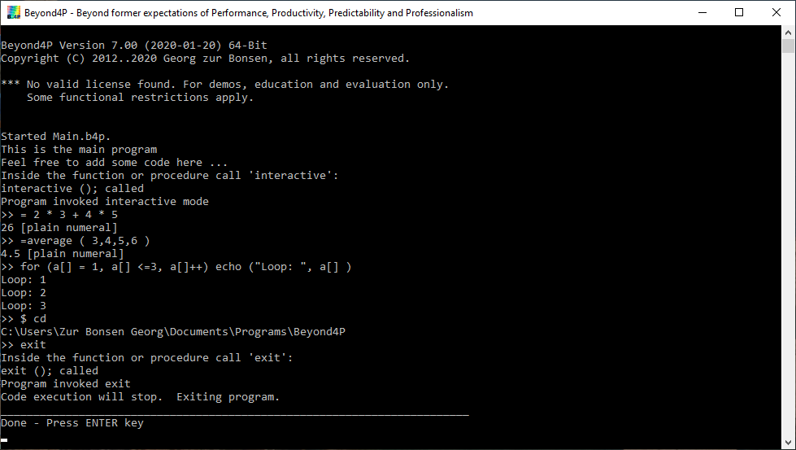
Beyond4P Installation and Getting Started Try interactive Mode
Interactive mode allows you to enter all Beyond4P statements, function calls, starting other programs, etc. from interactive mode.
If you start Beyond4P from start menu or click on "Main.b4p", then interactive mode follows after welcome text.
In Beyond4P programs, you can also use the interactive; statement to go interactive, do some inspections, then type return to continue running.
Interactive mode supports:
All Beyond4P statements entered and executed interactively
Use equal sign followed by expression to calculate a Beyond4P expression
Use dollar sign to enter operating system commands
Type "exit" to leave Beyond4P.

Slide 17
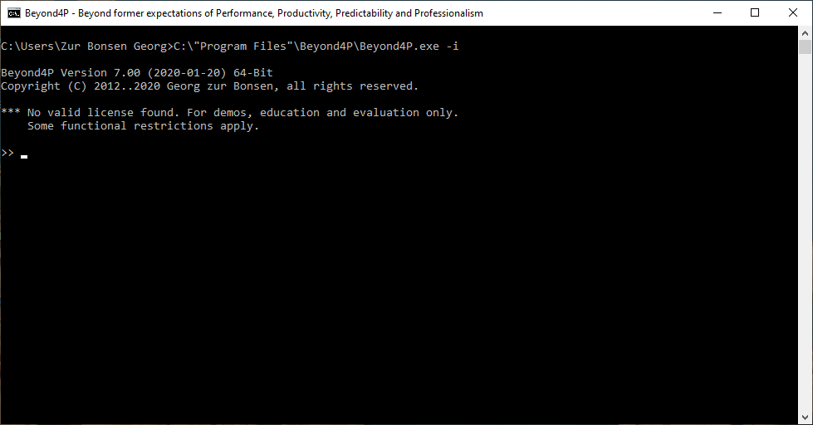
Beyond4P Installation and Getting Started Try interactive Mode
This is another way to start interactive mode directly.

Slide 18
Table of Contents
1. Installation on WINDOWS systems
2. Installation on LINUX systems

Slide 19
Beyond4P Installation and Getting Started LINUX
You should have available two compressed files:
B4P Installation.zip Lean installation package containing all necessary files
B4P Demo.zip Nice collection of demonstrator applications written in Beyond4P
Beyond4P Getting Started.pdf Guide to installation
The installation file is OS specific, but demo and PDF files are common.
LINUX users: The standard "zip" / "unzip" compression utility needs to be available in your distribution. Normally, this is the case.
Download is free of charge, "GNU Lesser Public License" (LPGL).
To install, use following commands (you may need to add 'sudo' in front of the command to install):
apt-get update
apt-get install zip unzip

Slide 20
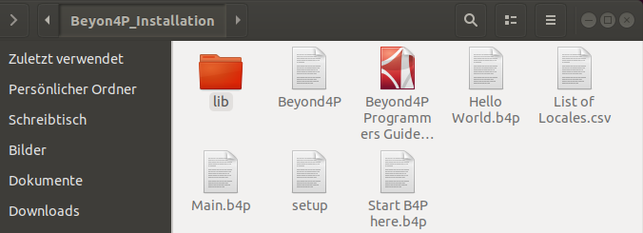
Beyond4P Installation and Getting Started Starting the Installation
Extract the .zip file on a new local directory.
You should see at least following files and subdirectories.
Most files will be copied into the location C:\Program Files (x86)\Beyond4P.

Slide 21
Beyond4P Installation and Getting Started B4P Installation.zip
Extract the .zip file on a new local directory.
setup Beyond4P installation script (written in Beyond4P code)
Beyond4P Actual Beyyond4P run time machine (language interpreter)
B4P Programmers Guide … .pdf Programmers guide
List of Locales.csv Contains locale information for a set of supported countries.
Start B4P here.b4p Small Beyond4P app which makes Beyond4P look for 'main.b4p' or 'main.txt' in this directory if not started with an B4P application script file (e.g. when starting Beyond4P from start menu or command line alone)
Main.b4p Typical main file. Put it in a favorable directory location (along with the file above).
Hello World.b4p Self-explanatory
Lib\.... Beyond4P library (contains 4 files, incl. Office and Excel related features)
Beyond4P License File.json Available if a valid license is provided.
Most files will be copied into the location C:\Program Files (x86)\Beyond4P.

Slide 22
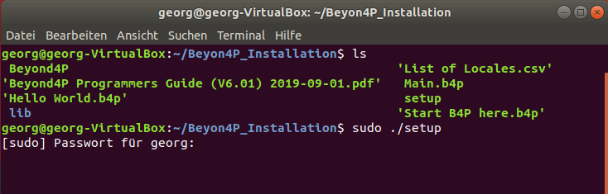
Beyond4P Installation and Getting Started Starting the Installation
Type sudo ./setup
sudo command prefix is needed for elevated privileges to install Beyond4P.
Due to small number of files, the installation process will be very fast (like Beyond4P itself!)
The setup is actually a Beyond4P script which can be executed like an executable or shell script file because it uses the Beyond4P run-time machine in this directory.
You may be requested to enter your password.
Most files will be copied into the location C:\Program Files (x86)\Beyond4P.

Slide 23
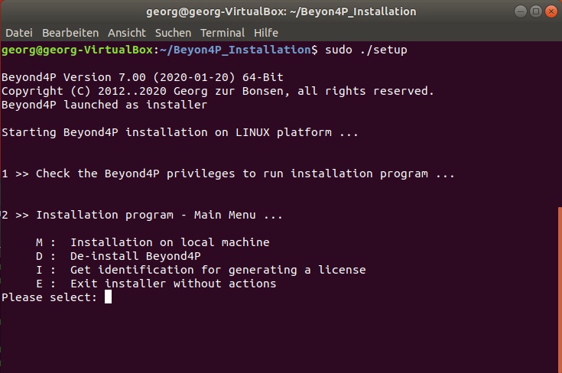
Beyond4P Installation and Getting Started Installation Options: Local Machine / Current User / De-Installation
Choose one of the options.
Press M for installation on the local machine. The installation will copy
The executable file to /usr/bin
The Beyond4P libraries to /etc/Beyond4P/ and
other files like user settings to /home/username/.config/Beyond4P/.

Slide 24
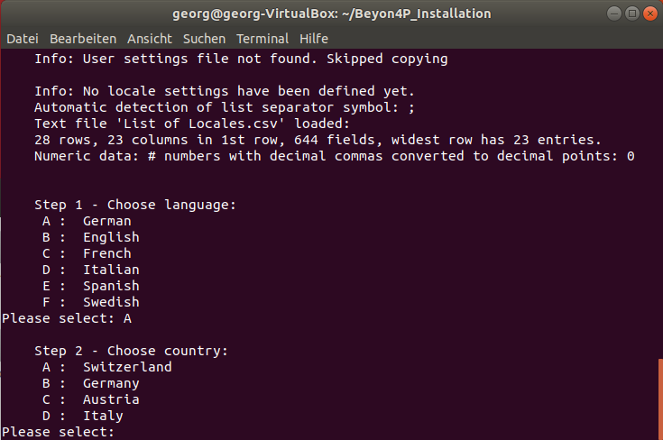
Beyond4P Installation and Getting Started Installation Options: Local Machine / Current User / De-Installation
Locale Settings
If no locale settings have been installed yet, then you will be asked for language followed by country.
If locale settings are found from a previous installation, then you will be asked if to use them again.
The list of countries is specific to the languages chosen.
Important: Please use the same locale settings as you are using for MS Excel (and not primarily where you are living) so no conflicts occur regarding decimal comma/points, thousand separators and list separators (, / ;).

Slide 25
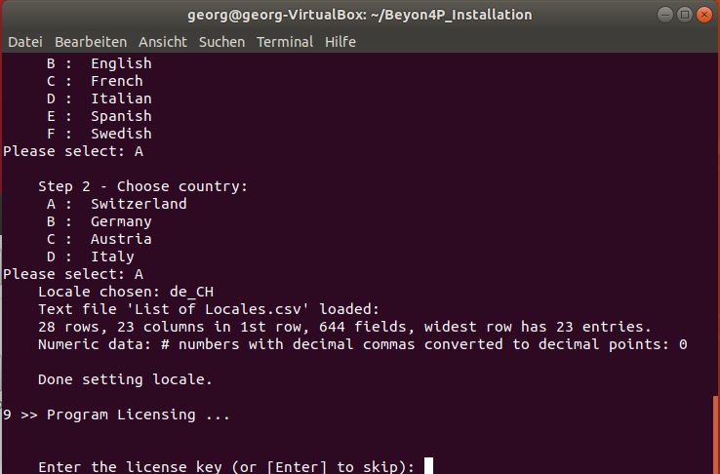
Beyond4P Installation and Getting Started License Key
If the installation file contains a license file or if your existing installation is already licensed, then you will be asked whether to use this one or not.
Without license key, Beyond4P runs in demo mode with full performance and functionality, but some restrictions apply:
5 'table save ...' operations per session
Max 300 rows allowed to save
Max 40 columns allowed to save
Either enter the license code (set of hexadecimal values, if available), just press [Enter] to skip.

Slide 26
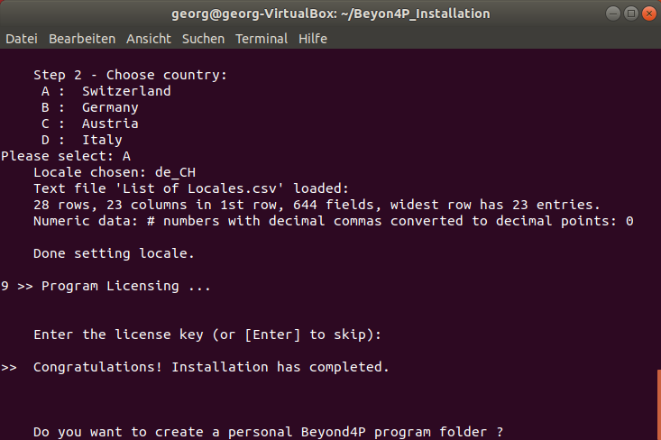
Beyond4P Installation and Getting Started Installation done, optional personal program folder
Roundup
The installation is ready.
You will be asked whether you want to have a personal program folder created where you can start "playing around".
For beginners: advisable to press Y.
Following folder will be created: /home/username/programs/Beyond4P
Afterwards, the installation is complete.

Slide 27
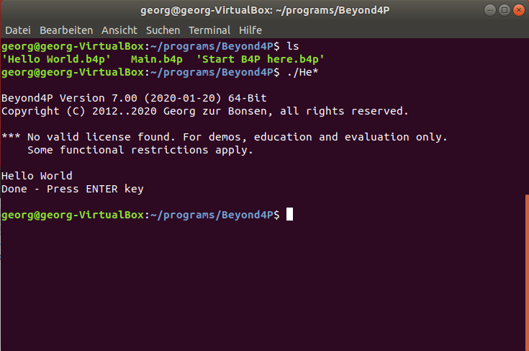
Beyond4P Installation and Getting Started First tries
Go to the new directory created:
cd /home/username/programs/Beyond4P
As long the Beyond4P application scripts contain the following LINUX "Chebang" statement on the 1st row, then you can start the Beyond4P scripts in the same way as you start shell scripts or executable files. 1st row must contain: #!/usr/bin/Beyond4P
LINUX shell allows wildcards, so typing ./He* will start 'Hello World.b4p' if no other file begins with "He" in the same directory.

Slide 28
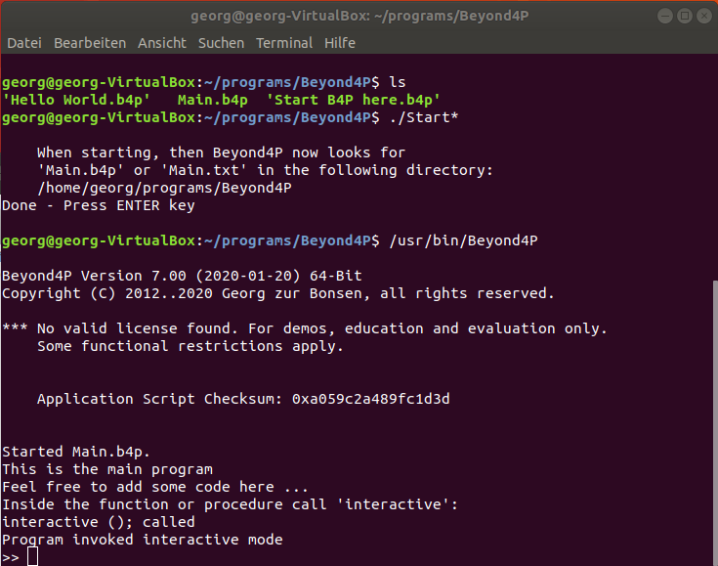
Beyond4P Installation and Getting Started Set the starting directory when launching Beyond4P directory.
Go to the new directory created:
cd /home/username/programs/Beyond4P
Run "Start B4P here.b4p". LINUX allows to short-cut the command by typing ./Start*
Now, beyond4P will look in this directory for "Main.b4p" or "Main.txt" if started autonomously without file name specified.
See example on the right where /usr/bin/Beyond4P or Beyond4P is typed in as command

Slide 29
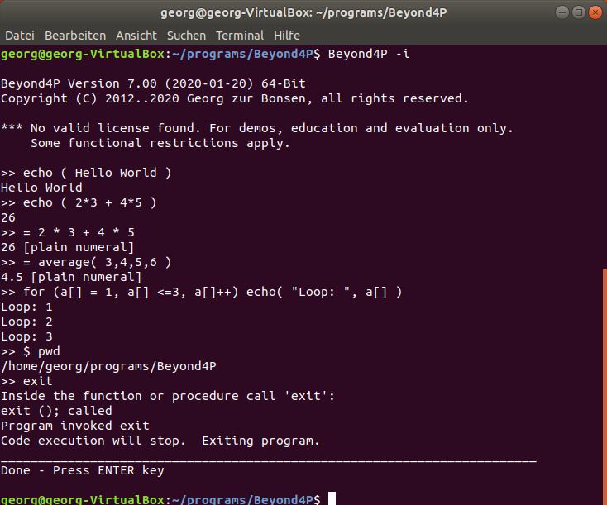
Beyond4P Installation and Getting Started Try interactive Mode
Interactive mode allows you to enter all Beyond4P statements, function calls, starting other programs, etc. from interactive mode.
Use -i switch to start Beyond4P in interactive mode.
In Beyond4P programs, you can also use the interactive; statement to go interactive, do some inspections, then type return to continue running.
Interactive mode supports:
All Beyond4P statements entered and executed interactively
Use equal sign followed by expression to calculate a Beyond4P expression
Use dollar sign to enter operating system commands
Type "exit" to leave Beyond4P.

Slide 30
Beyond4P Good Luck with Beyond4P Try the Demo files (separate ZIP)

